Slide 1
SMALL PRECISION TOOLS
Wedge Auto-Draw Requirements
Small Wire (SW) Wedge Series – COB Requirements (30COB - 45COB – 55COB – 60COB)
DOCUMENT NO.
DATE
PREPARED BY
STATUS
COB_REQ_Rev0_07162026
2026-16-07
Youssef
Draft

Slide 2
Scope
This document defines the production drawing, customer drawing, and overlay requirements for the COB Requirements (30COB - 45COB – 60COB) series, covering both the finished wedge and the Pre-Ground Blank (PGB).
SMALL PRECISION TOOLS
Confidential
04

Slide 3
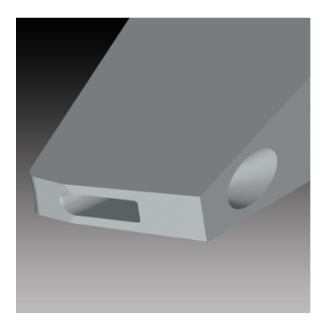
Tool Overview
The COB series incorporates all the common features of a wedge with the cavity guide design, which is widely used for small aluminum wire bonding. It comes with the elliptical back radius which keeps the wire in the center of the tool for better bond placement capability.
SMALL PRECISION TOOLS
Confidential
04

Slide 4
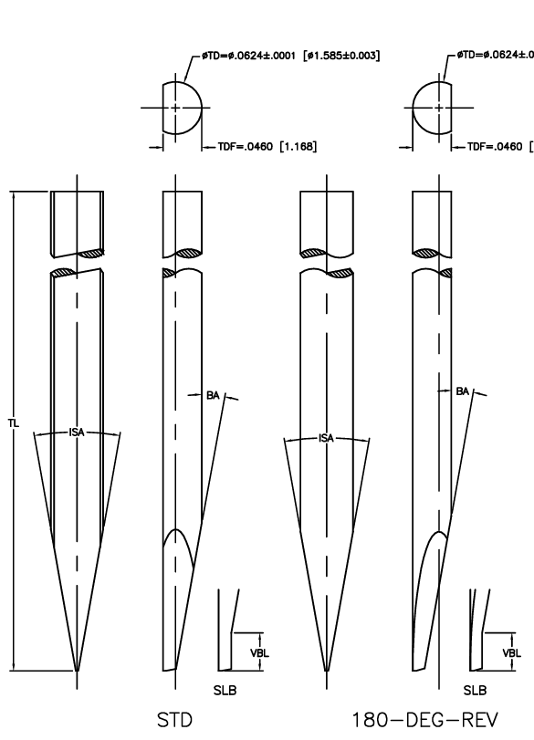
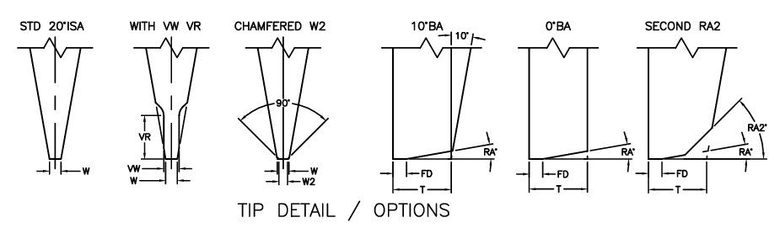
Configuration Options
Shank: SW_STD with SLB feature , 20 SW_180REV with SLB feature
For Tip detail we have STD 20°ISA , WITH VW VR , CHMFERED W2, 10°BA, 0°BA, SECOND RA2
SMALL PRECISION TOOLS
Confidential
04

Slide 5
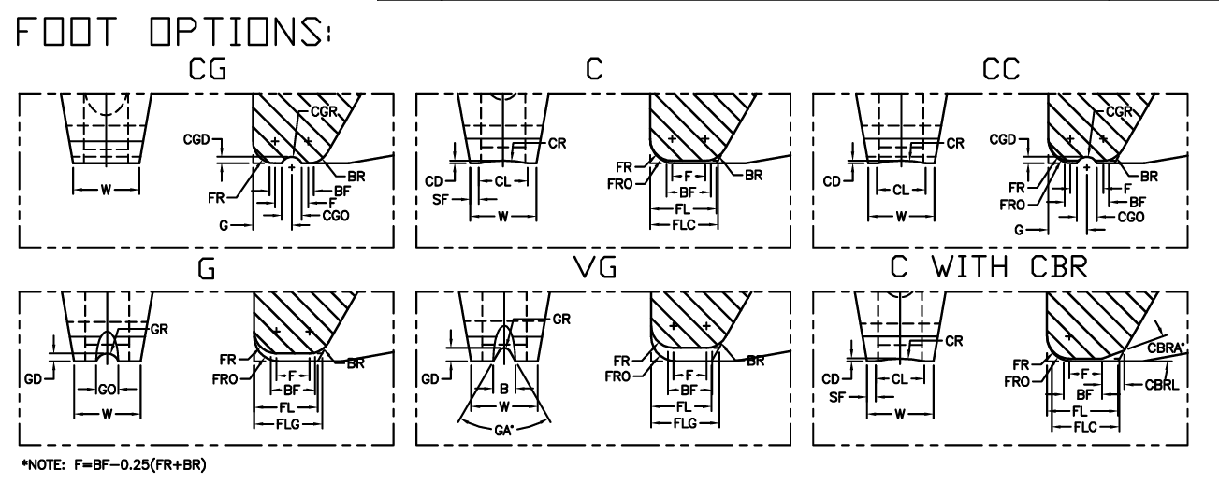
Configuration Options
Foot options: SW_C, SW_F, SW_CG, SW_G, SW_VG, SW_CC
SMALL PRECISION TOOLS
Confidential
04

Slide 6
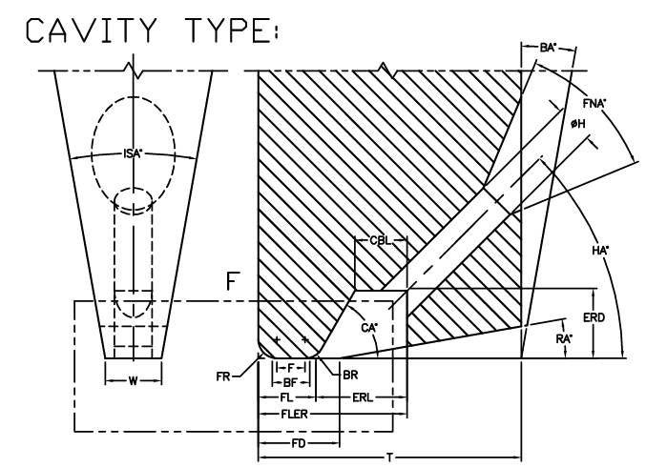
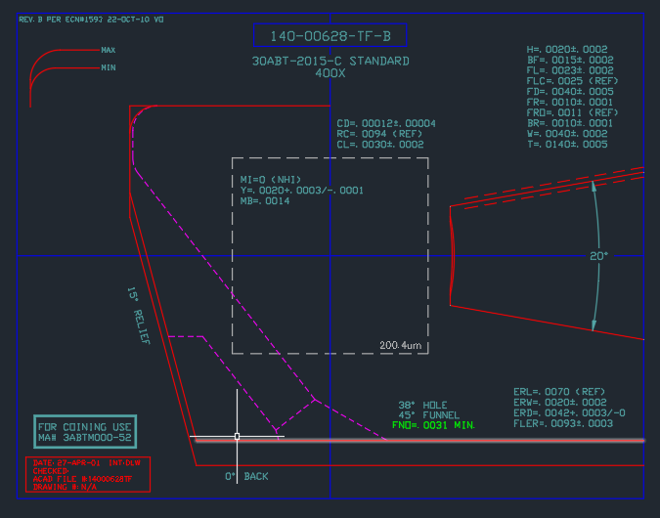
Configuration Options
Notch type: SW_Cavity,
Note : Main difference with COB is CA align with HA
SMALL PRECISION TOOLS
Confidential
04

Slide 7
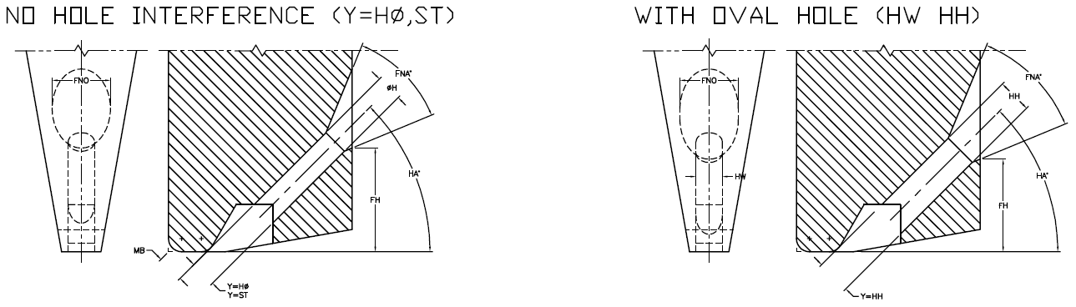
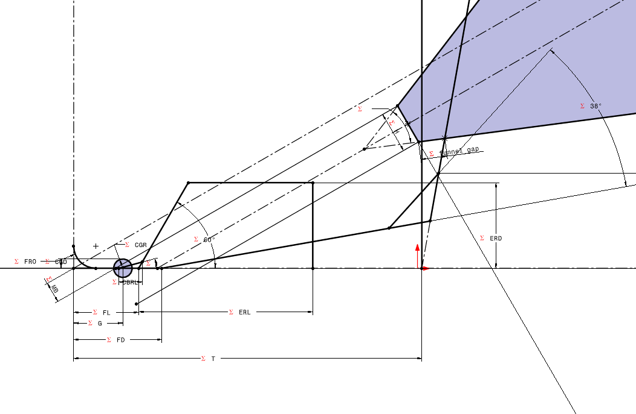
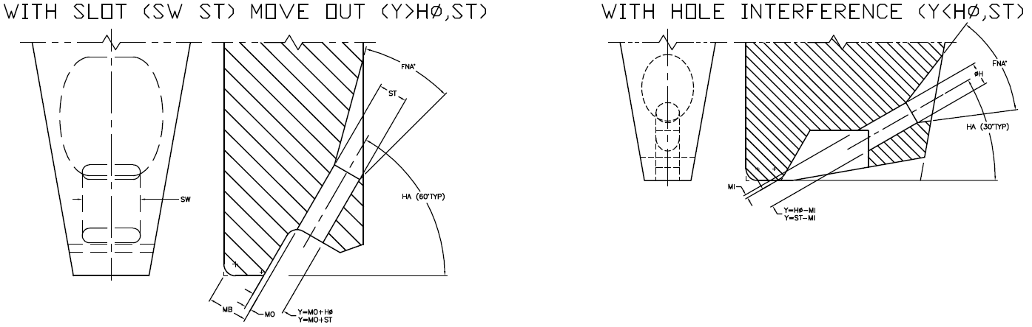
Configuration Options
Feed hole types: STD (Round), Oval, Slot
Note : Y will be used to position the hole
SMALL PRECISION TOOLS
Confidential
04

Slide 8
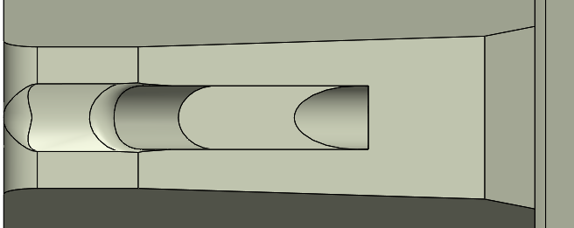


Configuration Options
BR feature: Round BR
Note : Round BR used the same as COB
SMALL PRECISION TOOLS
Confidential
04

Slide 9
Database Requirements
Schema is largely consistent with the COB tool family.
Note : We may need to add the fields like Wedge type; Foot type; etc. Note : Needed to add the angle for incline VFL !
SMALL PRECISION TOOLS
Confidential
04

Slide 10
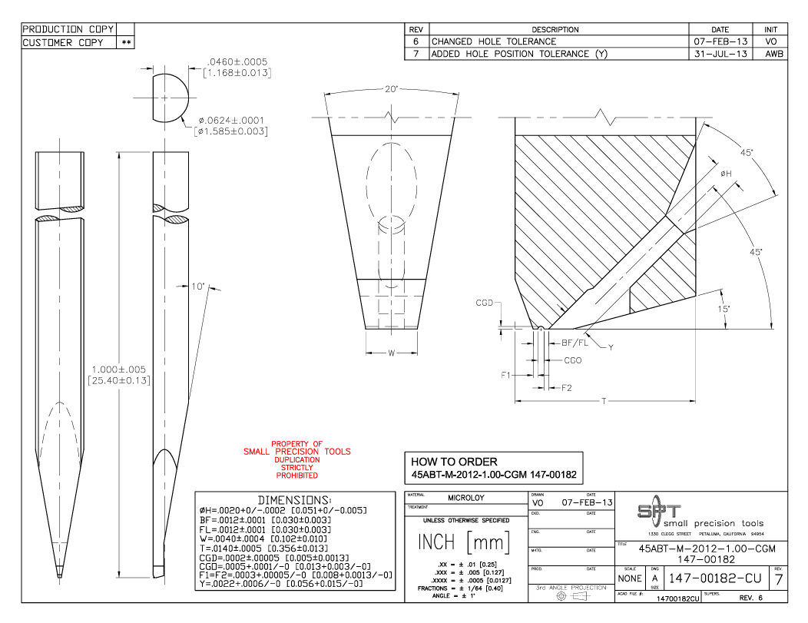
Customer Drawing Requirements
For customer drawing we will replicate as the same provided, following the same step as COB
Front, Right & Top Views
Detail & Section Views
Dimensions Tables
Note : Noticed the VFL has an angle, but Not define in the DB
SMALL PRECISION TOOLS
Confidential
04

Slide 11
Production Drawing Requirements
For customer drawing we will replicate as the same provided, following the same step as COB
Front, Right & Top Views
Detail & Section Views
Dimensions Tables
Add all dimensions and parameters to views
Note : Noticed the VFL has an angle, but Not define in the DB
SMALL PRECISION TOOLS
Confidential
04

Slide 12
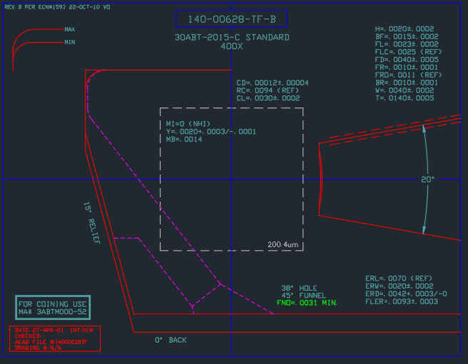
Overlay Requirements: Finish Wedge
Similar to COB overlay, with different tolerance zone construction. .
Note : Scaling the view the same way as COB Note : Only add two views to the overlays Note : No need to all the annotations
SMALL PRECISION TOOLS
Confidential
04

Slide 13
Overlay Requirements: PGB
Remains unchanged from the standard wedge overlay used across all tool families.
Note : PGB overlay may have VR/VW feature
SMALL PRECISION TOOLS
Confidential
04

